Slide 1
DISEASECARD
AGGREGATION AND VISUALIZATION OF RARE GENETIC DISEASES DATA
M3-Prototype
Projeto em Informática
2023-2024

Slide 2
01
OUR TEAM

Slide 3
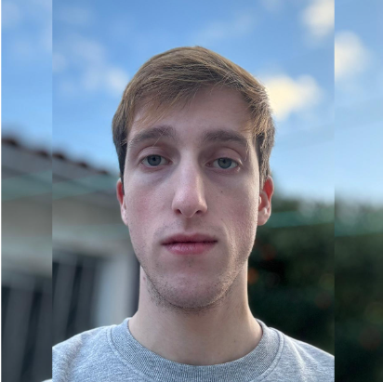
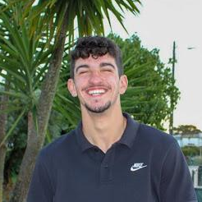
OUR TEAM
MATILDE TEIXEIRA
GUILHERME AMORIM
ALEXANDRE RIBEIRO
RAFAEL FERREIRA
RODRIGO GRAÇA
Project Manager
Product Owner
DevOps
Architect
Tester

Slide 4
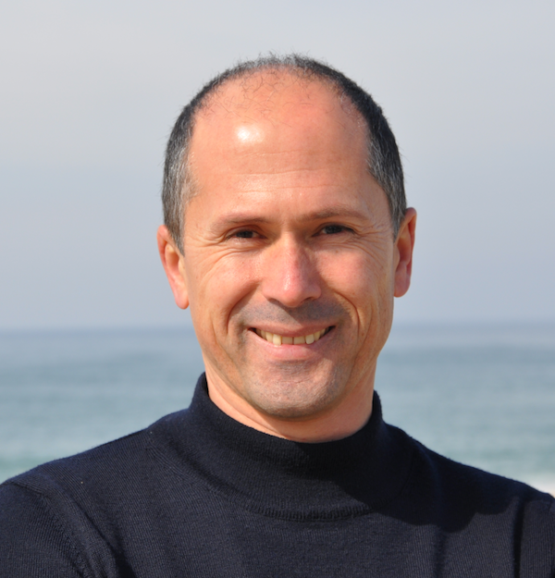
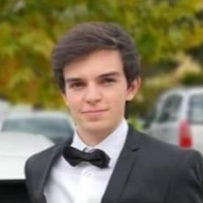
GUIDING TEACHERS
JOÃO ALMEIDA
JOSÉ OLIVEIRA
TIAGO ALMEIDA

Slide 5
02
CONTEXT
AND STATE OF THE ART

Slide 6
STATE OF THE ART
More info here
Features |  | Orphanet | Malacards | Disease Ontology | GARD | NORD | NCBI | UptoDate | DiseaseCard | Our DiseaseCard
Functional | Disease Summary | ✅ | ✅ | ❌ | ✅ | ✅ | ❌ | ✅ | ✅ | ✅
 | Search | ✅ | ✅ | ⚠️ | ✅ | ✅ | ✅ | ✅ | ✅ | ✅
 | Advanced Search | ✅ | ⚠️ | ✅ | ❌ | ❌ | ❌ | ❌ | ❌ | ✅
 | Auto-complete | ⚠️ | ⚠️ | ❌ | ✅ | ❌ | ✅ | ✅ | ⚠️ | ✅
 | Disease Categories | ✅ | ✅ | ✅ | ✅ | ❌ | ❌ | ✅ | ❌ | ✅
 | Related Diseases | ❌ | ✅ | ✅ | ❌ | ✅ | ❌ | ✅ | ❌ | ✅
 | News | ✅ | ✅ | ❌ | ✅ | ✅ | ❌ | ✅ | ❌ | ✅
 | Drugs/ Treatments | ✅ | ✅ | ❌ | ✅ | ✅ | ❌ | ✅ | ⚠️ | ✅
 | Symptoms | ✅ | ✅ | ❌ | ✅ | ✅ | ❌ | ✅ | ⚠️ | ✅
 | AI Assisted Search | ❌ | ❌ | ❌ | ❌ | ❌ | ❌ | ❌ | ❌ | ⚠️

Slide 7
03
GOALS AND REQUIREMENTS GATHERING

Slide 8
GOALS
Data Collection and Integration
Activity Monitoring
Web Interface for Search
Conversational Search System
Protected Backoffice

Slide 9
REQUIREMENTS GATHERING
Brainstorming amongst the team
Gathering information from related websites
Interviewing medicine students
Studying previous work

Slide 10
04
REQUIREMENTS

Slide 11
FUNCTIONAL REQUIREMENTS
Disease Information
Daily
Updates
Flexible and Accessible Search
Secure Authentication (Admin)
Endpoint Monitoring (Admin)
CRUD Methods (Admin)

Slide 12
NON-FUNCTIONAL REQUIREMENTS
Modular Architecture
Accessibility
High Performance
Scalability

Slide 13
05
ACTORS

Slide 14
ACTORS
User
Admin

Slide 15
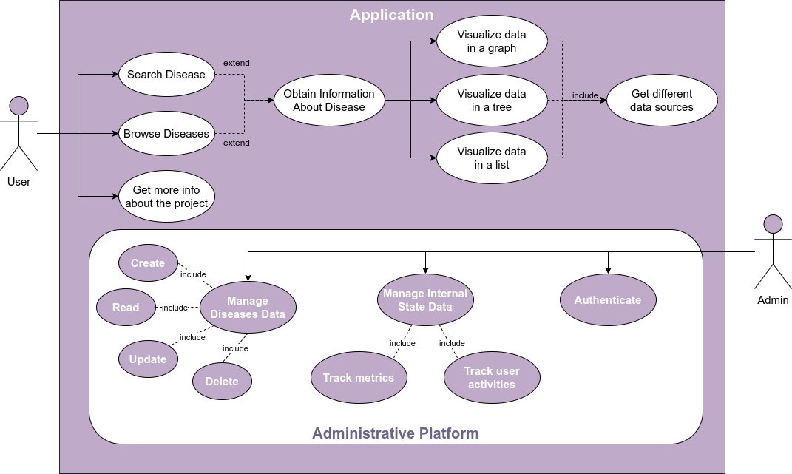

Slide 16
06
ARCHITECTURE

Slide 17
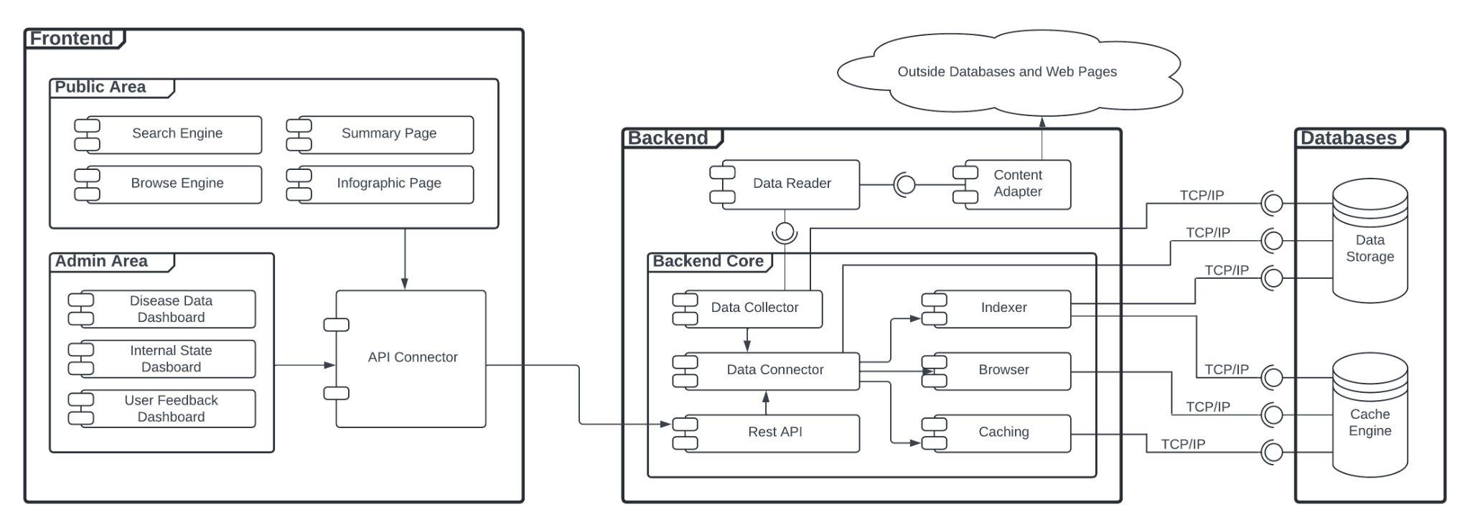
ARCHITECTURE
Enterprise Architecture

Slide 18
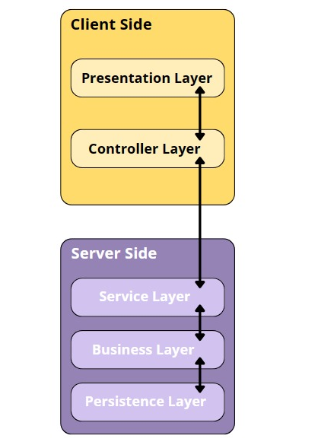
ARCHITECTURE
Layer Architecture

Slide 19
07
DOMAIN MODEL

Slide 20
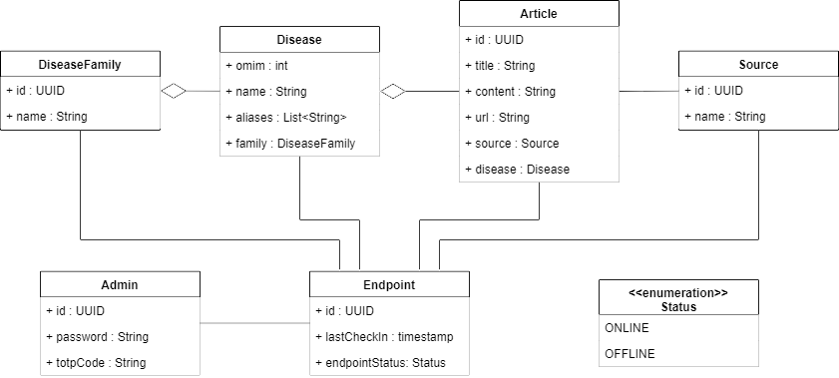
DOMAIN MODEL

Slide 21
08
DEMO

Slide 22
09
CALENDAR

Slide 23
MARCH |  |  |  | 01 | 02 | 03
04 | 05 | 06 | 07 | 08 | 09 | 10
11 | 12 | 13 | 14 | 15 | 16 | 17
18 | 19 | 20 | 21 | 22 | 23 | 24
25 | 26 | 27 | 28 | 29 | 30 | 31
05
Communication Plan
05
08
08
Database Decision
Backend Decision
11
12
11
Database Structure
Start prototype
12
M2 - Architecture Presentation

Slide 24
02
CheckPoint
01 | 02 | 03 | 04 | 05 | 06 | 07
08 | 09 | 10 | 11 | 12 | 13 | 14
15 | 16 | 17 | 18 | 19 | 20 | 21
22 | 23 | 24 | 25 | 26 | 27 | 28
29 | 30 |  |  | APRIL
02
08
Frontend Development
08
15
Modelling Database
Testing Endpoints
15
16
16
23
15
M3 - Prototype Presentation
Main Deployment
22
23
22
16
23
M3 - Prototype Presentation
Data Normalization
30
22
30
Data Normalization
Main Deployment

Slide 25
06
Monitoring
Authentication
MAY |  | 01 | 02 | 03 | 04 | 05
06 | 07 | 08 | 09 | 10 | 11 | 12
13 | 14 | 15 | 16 | 17 | 18 | 17
20 | 21 | 22 | 23 | 24 | 25 | 26
27 | 28 | 29 | 30 | 31 | 01
07
21
Checkpoint
06
07
17
CRUD
17
23
24
Usability and Normalization Tests
27
Frontend Development
Monitoring Interface Test
21
23
24
28
30
Deliveries
27
28
30
01
01
Final Deployment
Detailed Project Calendar

Slide 26
Thanks!
You can visit our Microsite here!
SCAN ME
Alexandre Ribeiro, 108122
Guilherme Amorim, 107162
Matilde Teixeira, 108193
Rafael Ferreira, 107340
Rodrigo Graça, 107634
‹#›

